Slide 1

Website Development: Lesson 10
Facilitated by Titus Kariuki
Notes:
Web development kahoot

Slide 2
Agenda
1. Ice breaker
2. Recap
Finish up Previous Projects
3. Introduction to Final Project!
4. Template vs. Website from Scratch
5. VS Code

Slide 3

Ice Breaker
If you were in Avatar, which element would you bend, and why?

Slide 4

Ice Breaker

Slide 5
Previous Projects

Slide 6
Recap: Past Projects
Project | Tool
Poem | Basic HTML Text tags
List of ASP activities | Ordered and unordered lists
Your favorite picture | Image tags
Your favorite animal | CSS
 | IDs, iFrames
Links you love | Hyperlinks, Jumping

Slide 7
Recap: Past Projects
Project | Tool
Your favorite cartoons | Tables
A recipe book | All the above
Your Summer plans | Padding, margins
Navigation Bar | NavBar

Slide 8
Final Project
We will create websites for businesses

Slide 9
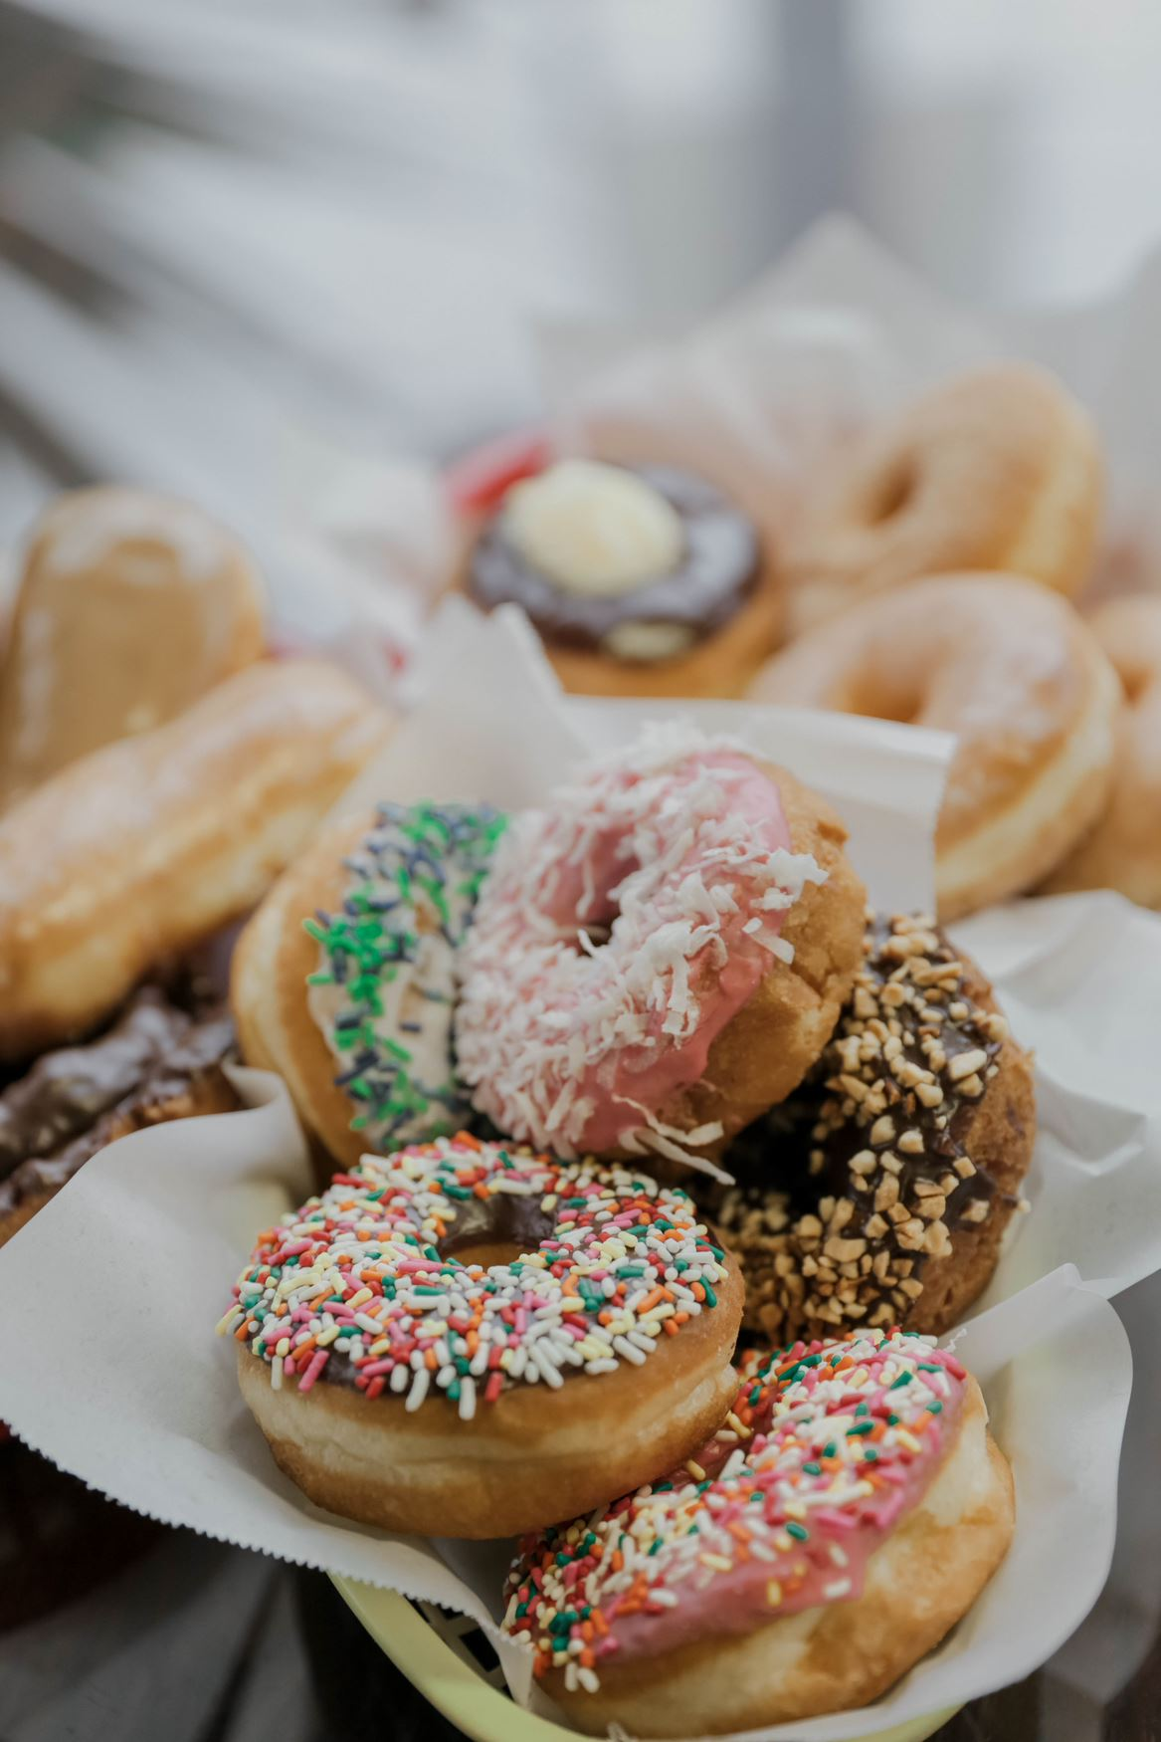
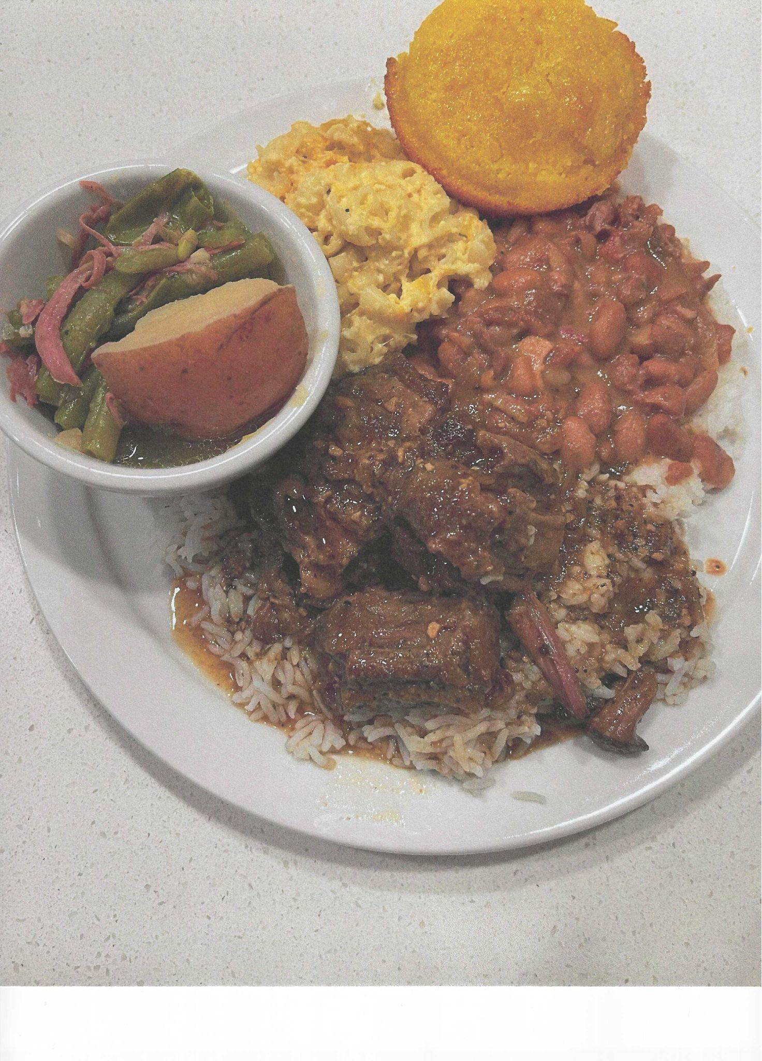
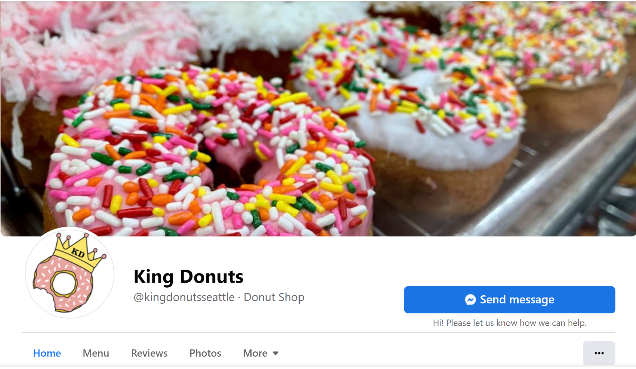

Business Info
Kim’s Savory Kuisines, LLC
King Donuts

Slide 10
Business Info
Kim’s Savory Kuisines, LLC
Owner: Kimberli Johnson
Location of Business: Kent, WA
Hours of Operation: 12-8p
Menu Items: caterer, meal prep, special events, cooking parties, cooking classes (adults & youths) romantic dinners, dinner parties, sport events, meals cooked for families, weekend dinner plates, and so much more..
Personal Biography: I've been in business over 20 years. Cooking is my passion. I love cooking and people love Eating what I cook.
Colors: Pink, Blue, Gray and Black (student can select pantone)
Needed on site: Payment Processing, Catering form
King Donuts
Owners: Hong Chhuor, Kien Sok
Location of Business: 9232 Rainier Ave S
Hours of Operation: M-F | 7a-1p, SSu | 7a-7p
Social Media: https://www.facebook.com/kingdonutsseattle/ https://www.instagram.com/king_donuts_seattle_washington/?hl=en
Business Bio: family owned and operated immigrant/refugee owned small business in our community for 30+ years donuts hand-made fresh daily
Personal Bio: Our family arrived in the US in mid 1980s and donuts have been a part of our story ever since. We take pride in serving hand made donuts made daily.
Needed on site: Payment Processing, Contact Form, Gift cards
Colors: Hex FBFCF1, Hex FDEB70,

Slide 11
Template Vs. From Scratch
Groups will have the choice to build their website using a template or from scratch

Slide 12
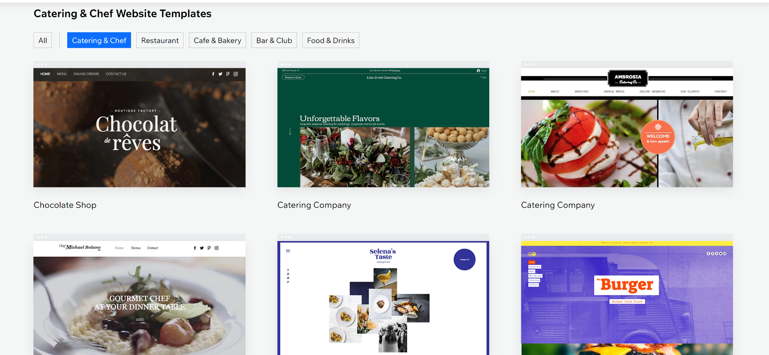
Templates
List of Templates:
https://github.com/website-templates
https://themes.3rdwavemedia.com/freebies/
https://startbootstrap.com/
https://freehtml5.co/
https://www.w3schools.com/w3css/w3css_templates.asp
https://uideck.com/templates/
https://graygrids.com/
https://onepagelove.com/templates/free-templates
https://www.free-css.com/template-categories/cafe-or-restaurant
https://templatemo.com/tag/restaurant
Templates are premade web pages that you can redesign and add your own stylistic elements

Slide 13
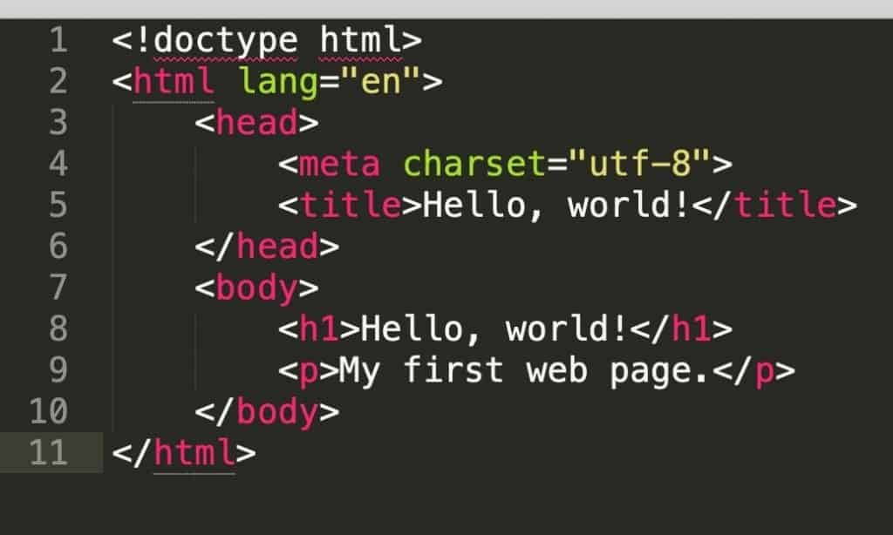
Coding Website from Scratch
If your group chooses to code the website from scratch, you will be using VS code to create a series of webpages (similar to our challenge projects) and putting them all together in the end

Slide 14
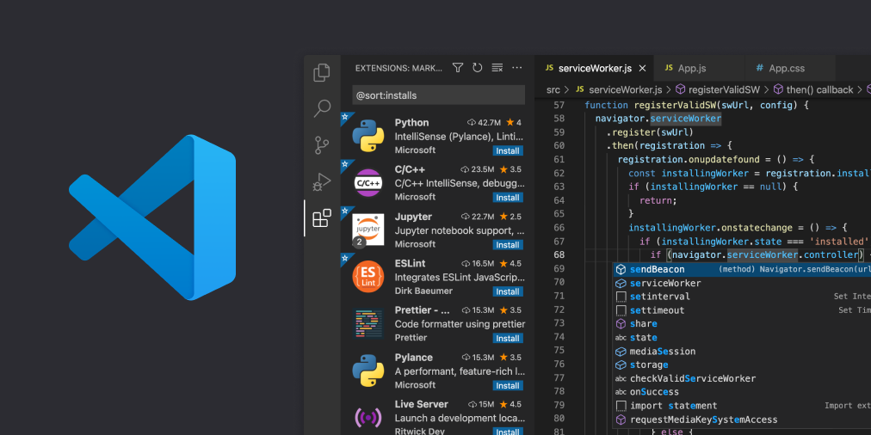
Introduction to VS Code

